Slide 1
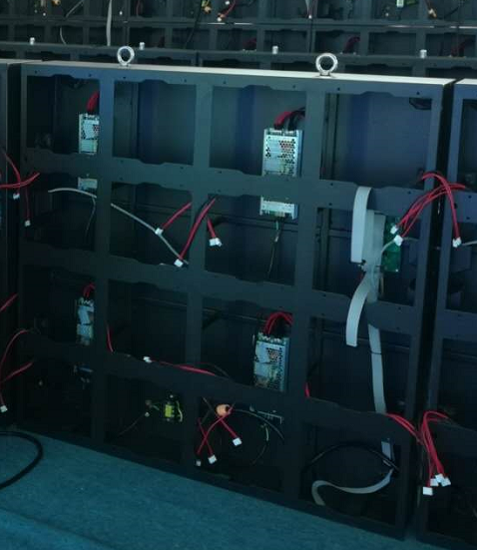
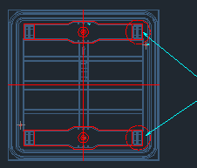
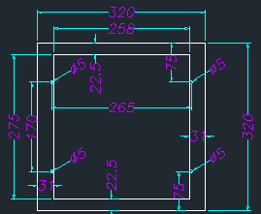
Cabinet :
Make 5 windows on corresponding position of Cross in front
The back can be a complete sheet, welding some Threaded poles to mount power supplies, Receiving Card, T3 Card
If it works in very hot temperature, a fan can be added for cooling
All parts can be assembled and dismounted from front
Reserve a hole for AC Mains power cable input
Reserve 2 holes for T3 Card Antennas
Keep all holes and fixing positions water resisted.
P10 Module: 320x320x22mm
Cabinet Reference
Locks

Slide 2
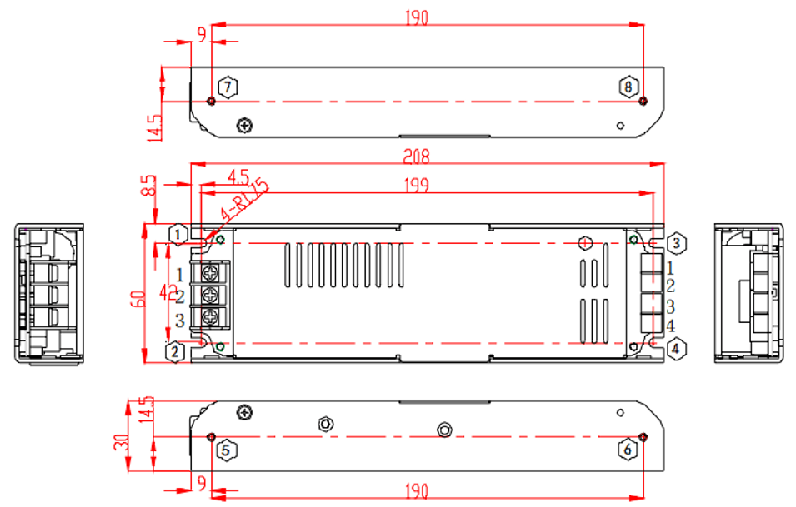
Power Supply: VAT-UP300S-5-60L-A

Slide 3
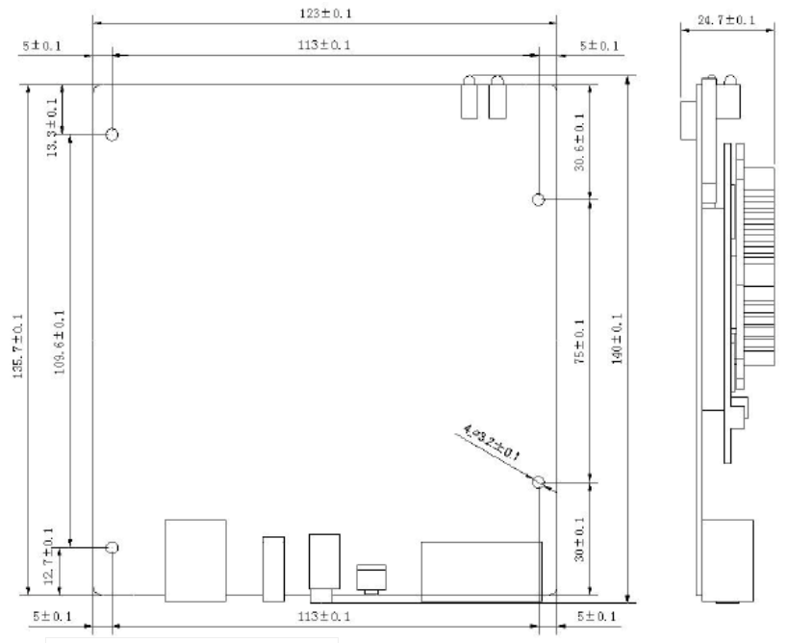
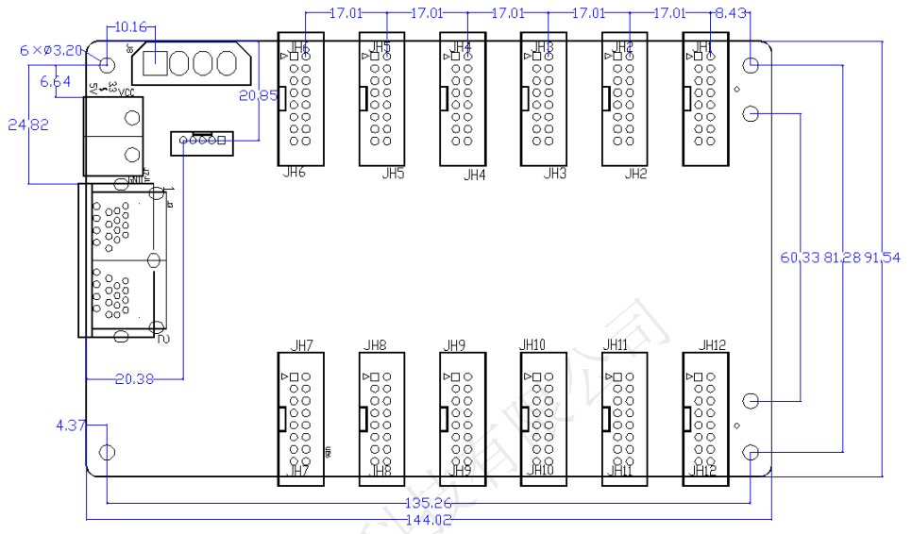
WiFi Sending Card: T3
Receiving Card: MRV336

